Slide 1
Introduction to Basic Python Programming

Slide 2
Python Keywords
Keywords are the reserved words in Python.

Slide 3
We cannot use a keyword as a variable name, function name or any other identifier. They are used to define the syntax and structure of the Python language.
In Python, keywords are case sensitive.
There are 33 keywords in Python 3.7. This number can vary slightly over the course of time.

Slide 4
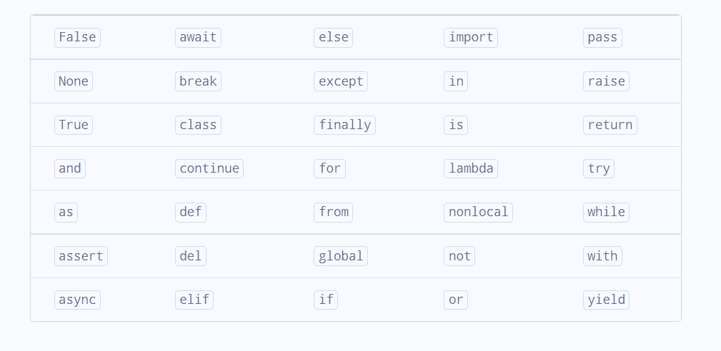

Slide 5
Python Identifiers
An identifier is a name given to entities like class, functions, variables, etc. It helps to differentiate one entity from another.

Slide 6
Python Data Types
Data types in Python
Every value in Python has a datatype. Since everything is an object in Python programming, data types are actually classes and variables are instance (object) of these classes.

Slide 7
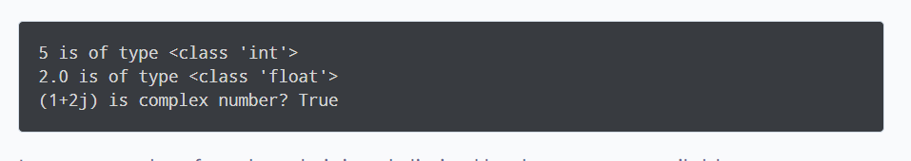
a = 5 print(a, "is of type", type(a))
a = 2.0 print(a, "is of type", type(a))
a = 1+2j
print(a, "is complex number?", isinstance(1+2j,complex))

Slide 8
Python List:
a = [1, 2.2, 'python']

Slide 9
Python Tuple:
t = (5,'program', 1+3j)

Slide 10
Python Strings
s = "This is a string"
print(s) s = '''A multiline string''' print(s)

Slide 11
Python Set:
a = {5,2,3,1,4}
# printing set variable
print("a = ", a)
# data type of variable a
print(type(a))

Slide 12
Python Dictionary:
d = {1:'value','key':2}
type(d)
<class 'dict'>

Slide 13
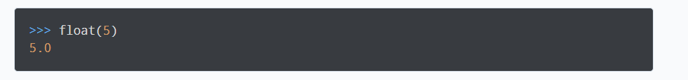
Conversion between data types:
We can convert between different data types by using different
type conversion functions like int(), float(), str(), etc.

Slide 14
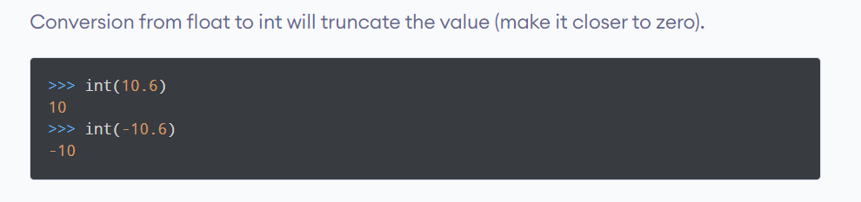

Slide 15
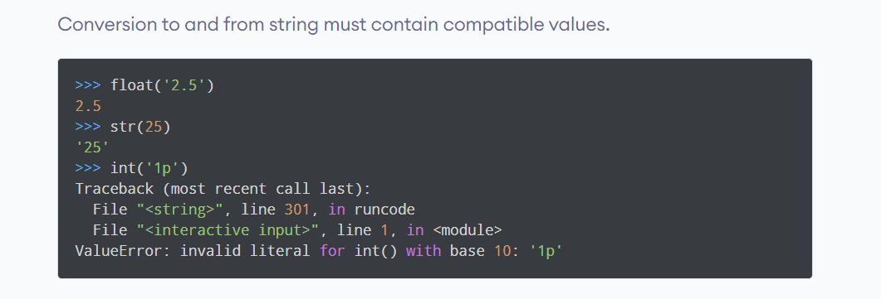

Slide 16
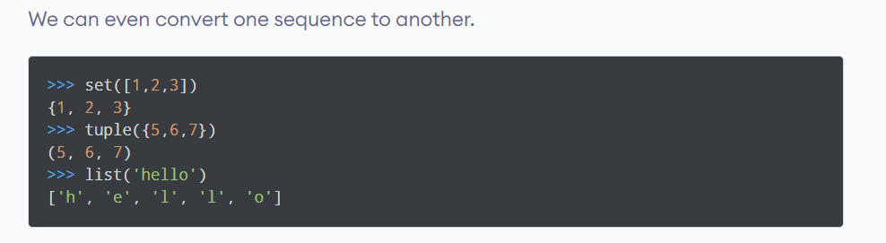

Slide 17
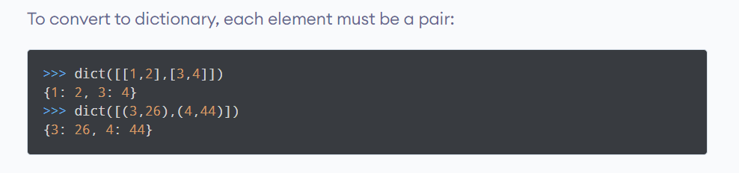

Slide 18
Python Type Conversion and Type Casting:
Type Conversion:
The process of converting the value of one data type (integer, string, float, etc.) to another data type is called type conversion. Python has two types of type conversion.
Implicit Type Conversion
Explicit Type Conversion

Slide 19
Implicit Type Conversion
In Implicit type conversion, Python automatically converts one data type to another data type. This process doesn't need any user involvement.

Slide 20
Converting integer to float:
num_int = 123
num_flo = 1.23
num_new = num_int + num_flo
print("datatype of num_int:",type(num_int))
print("datatype of num_flo:",type(num_flo))
print("Value of num_new:",num_new)
print("datatype of num_new:",type(num_new))

Slide 21
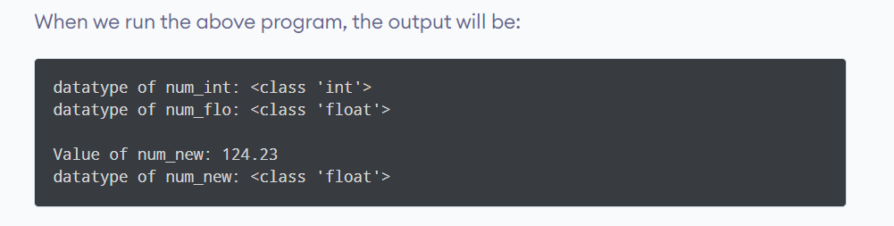

Slide 22
Addition of string(higher) data type and integer(lower) datatype
num_int = 123
num_str = "456"
print("Data type of num_int:",type(num_int))
print("Data type of num_str:",type(num_str))
print(num_int+num_str)

Slide 23
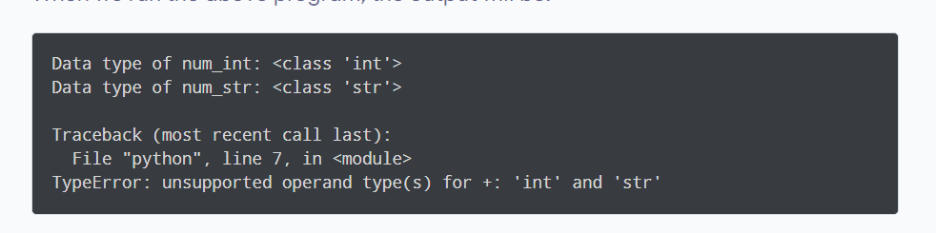

Slide 24
Explicit Type Conversion
In Explicit Type Conversion, users convert the data type
of an object to required data type. We use the predefined
Functions like int(), float(), str(), etc to perform explicit
type conversion.

Slide 25
Addition of string and integer using explicit conversion
num_int = 123
num_str = "456"
print("Data type of num_int:",type(num_int))
print("Data type of num_str before Type Casting:",type(num_str))
num_str = int(num_str)
print("Data type of num_str after Type Casting:",type(num_str))
num_sum = num_int + num_str
print("Sum of num_int and num_str:",num_sum)
print("Data type of the sum:",type(num_sum))

Slide 26
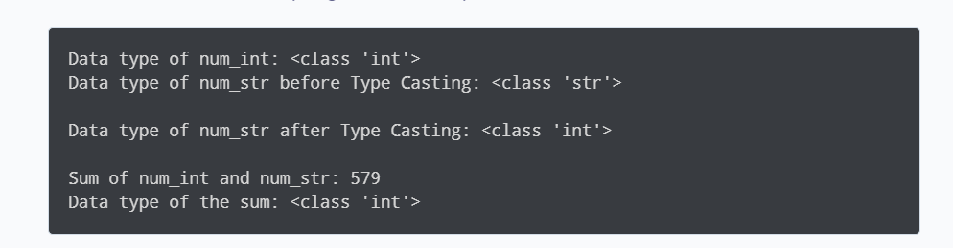

Slide 27
Python operators:
Operators are special symbols in Python that carry out arithmetic or logical computation. The value that the operator operates on is called the operand.

Slide 28
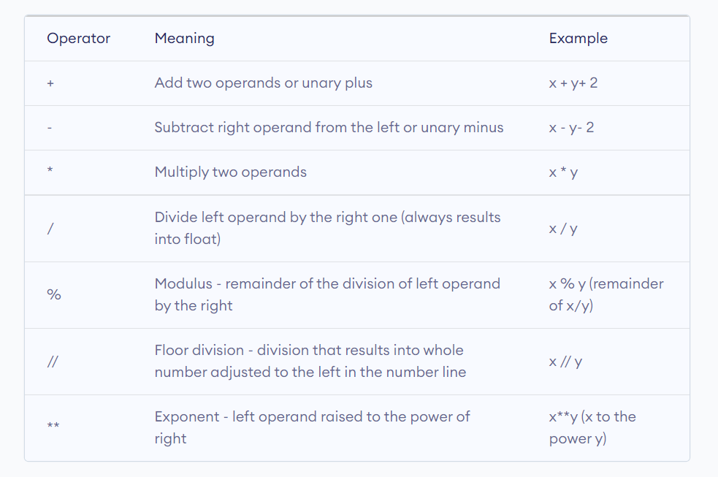

Slide 29
Arithmetic operators in Python:
x = 15
y = 4
# Output: x + y = 19
print('x + y =',x+y)
# Output: x - y = 11
print('x - y =',x-y)
# Output: x * y = 60
print('x * y =',x*y)

Slide 30
# Output: x / y = 3.75
print('x / y =',x/y)
# Output: x // y = 3
print('x // y =',x//y)
# Output: x ** y = 50625
print('x ** y =',x**y)

Slide 31
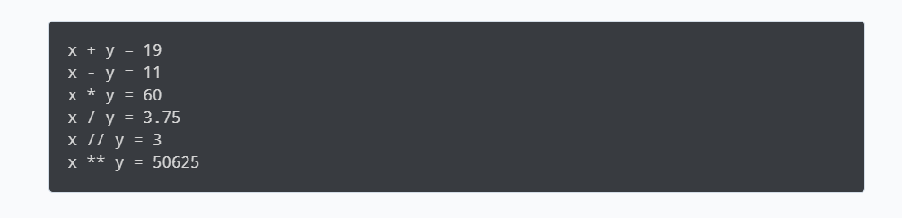

Slide 32
# Examples of Arithmetic Operator
a = 9
b = 4
# Addition of numbers
add = a + b
# Subtraction of numbers
sub = a - b
# Multiplication of number
mul = a * b
# Division(float) of number
div1 = a / b
# Division(floor) of number
div2 = a // b

Slide 33
# Modulo of both number
mod = a % b
# Power
p = a ** b
# print results
print(add)
print(sub)
print(mul)
print(div1)
print(div2)
print(mod)
print(p)

Slide 34
Comparison operators:
Comparison operators are used to compare values.
It returns either True or False according to the condition.

Slide 35
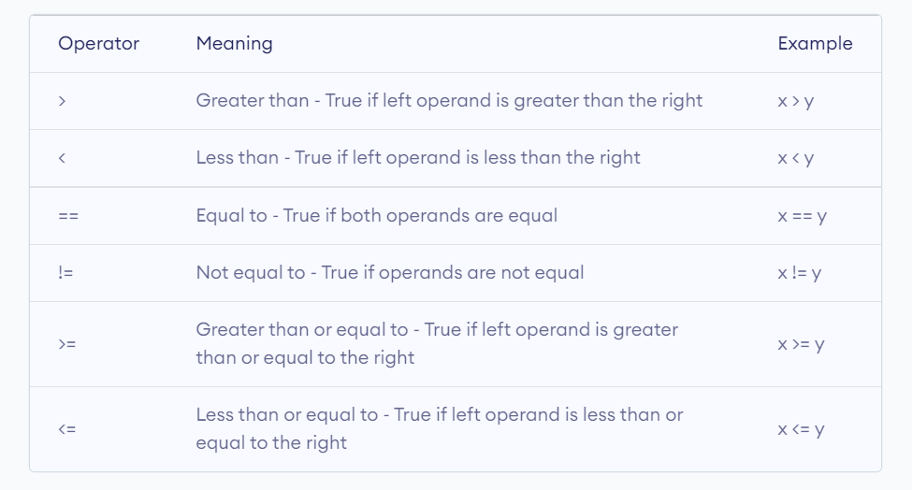

Slide 36
Comparison operators in Python:
x = 10
y = 12
# Output: x > y is False
print('x > y is',x>y)
# Output: x < y is True
print('x < y is',x<y)
# Output: x == y is False
print('x == y is',x==y)

Slide 37
# Output: x != y is True
print('x != y is',x!=y)
# Output: x >= y is False
print('x >= y is',x>=y)
# Output: x <= y is True
print('x <= y is',x<=y)

Slide 38
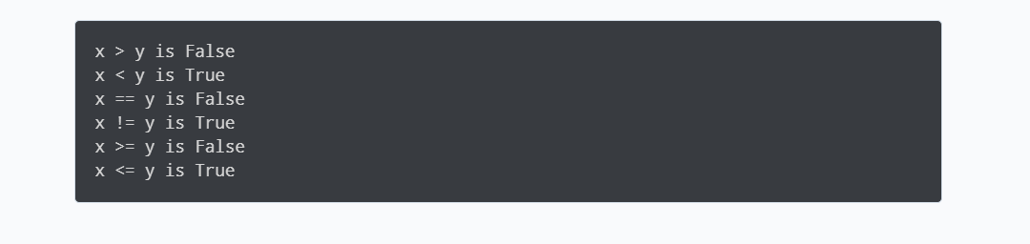

Slide 39
# Examples of Relational Operators
a = 13
b = 33
# a > b is False
print(a > b)
# a < b is True
print(a < b)
# a == b is False
print(a == b)
# a != b is True
print(a != b)
# a >= b is False
print(a >= b)
# a <= b is True
print(a <= b)

Slide 40
Bitwise Operators:
# Examples of Bitwise operators
a = 10
b = 4
# Print bitwise AND operation
print(a & b)
# Print bitwise OR operation
print(a | b)
# Print bitwise NOT operation
print(~a)
# print bitwise XOR operation
print(a ^ b)
# print bitwise right shift operation
print(a >> 2)
# print bitwise left shift operation
print(a << 2)

Slide 41
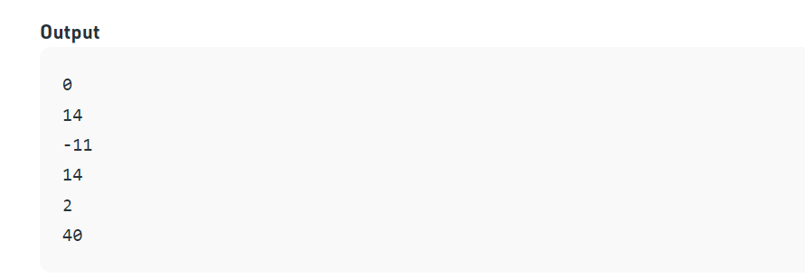

Slide 42
Assignment operators:

Slide 43
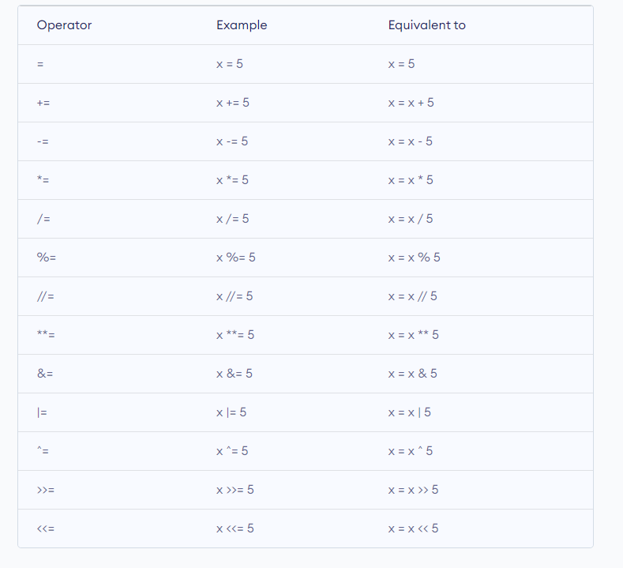

Slide 44
# Examples of Assignment Operators
a = 10
# Assign value
b = a
print(b)
# Add and assign value
b += a
print(b)
# Subtract and assign value
b -= a
print(b)
# multiply and assign
b *= a
print(b)
# bitwise lishift operator
b <<= a
print(b)

Slide 45
